Slide 1


Cyber Safety for Students
Name: Supriya
Trade: AIPA

Slide 2

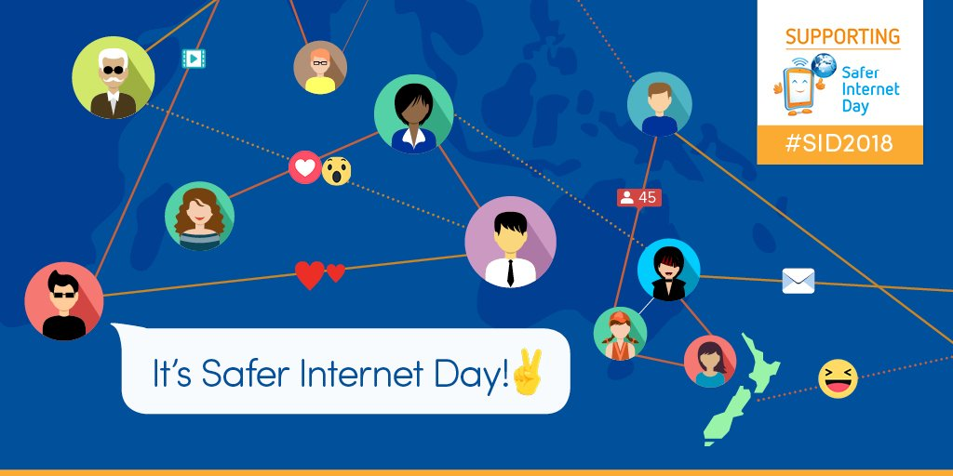
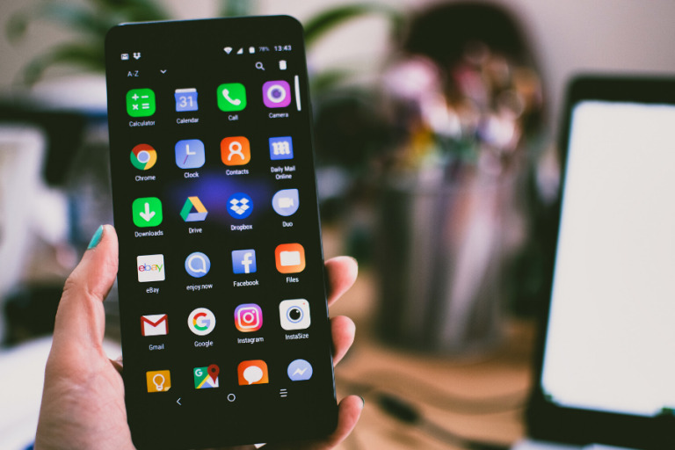
Introduction
Cyber safety means staying safe while using the internet and digital devices.
Students use the internet for learning, communication and entertainment.
Being careful online helps protect personal information and accounts.
Good cyber habits can prevent online scams and cyber attacks.

Slide 3

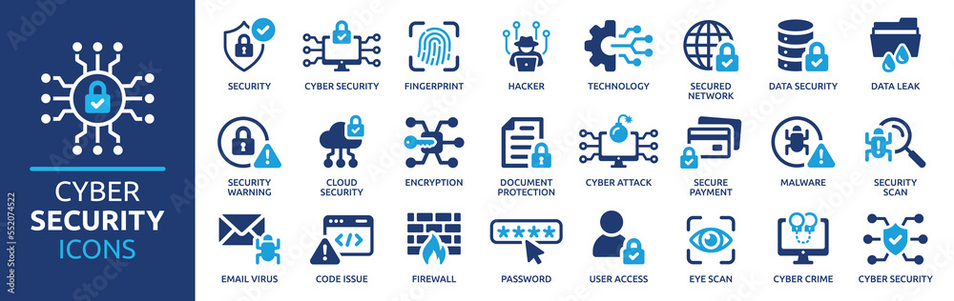
Common Cyber Threats
Phishing
Malware and Viruses
Cyberbullying
Identity Theft
Fake Accounts
Online Scams

Slide 4

Phishing & Online Scams
What is Phishing?
Phishing is an attempt to trick people into sharing passwords, OTPs or personal information.
Fake Message
1
Suspicious Link
2
Personal Information
3
Account Theft
4

Slide 5
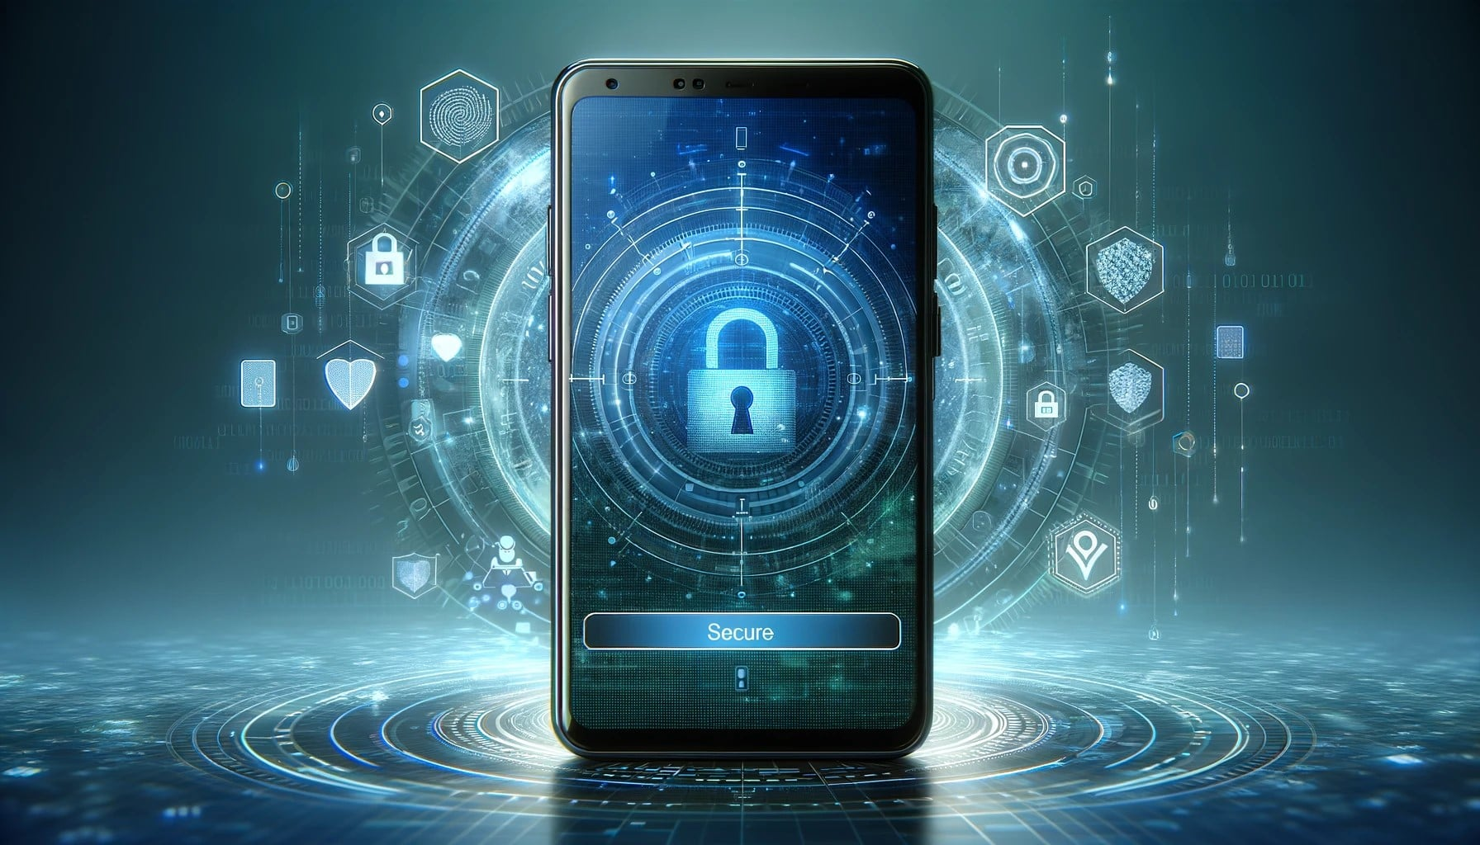
Password Security
Use a long and strong password.
Uses a combination of letters, numbers and symbols.
Never share your password with others.
Use different passwords for important accounts.
Turn on two-factor authentication when available.

Slide 6

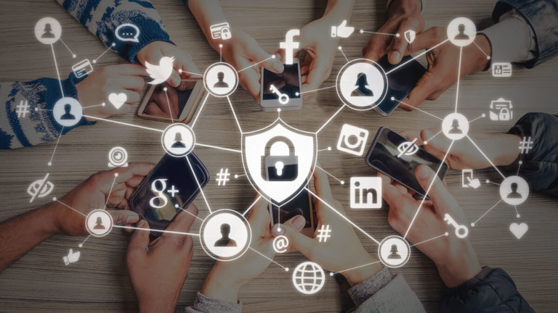
Social Media Safety
Keep your account privacy settings enabled.
Do not share your address , phone number or passwords.
Avoid accepting unknown friend requests.
Think before posting photos or personal information.
Report and block suspicious or abusive accounts.

Slide 7

Safe Internet Browsing
Open Website
Check the website address before entering information.
Prefer secure websites.
Don’t download files from unknown sources.
Avoid suspicious pop-ups and links.
Check Website Address
Is it Safe?
YES Continue
NO Leave Website

Slide 8

Cyber Safety Checklist
Safety Rule | Done
Use strong passwords
Enable 2FA
Keep accounts private
Avoid suspicious links
Don’t share OTP
Update software

Slide 9
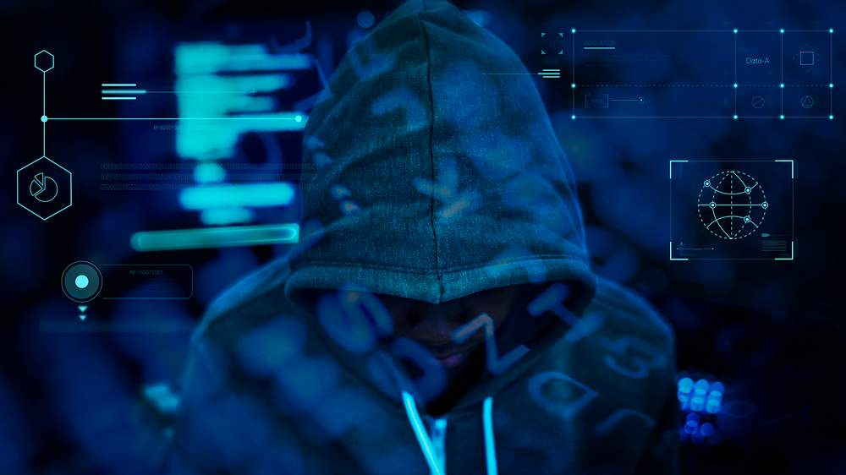
Conclusion
Think before you click.
Keep your passwords private.
Protect your personal information.
Be careful on social media.
Report suspicious online activity.
“Stay Safe Online!”

Slide 10


